Slide 1
Colour Shaper

Slide 2
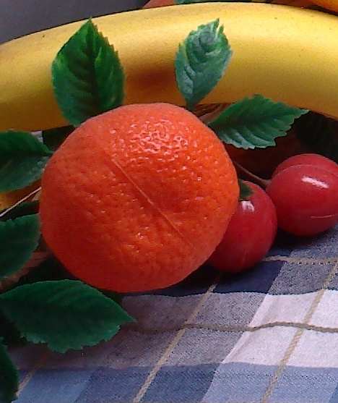
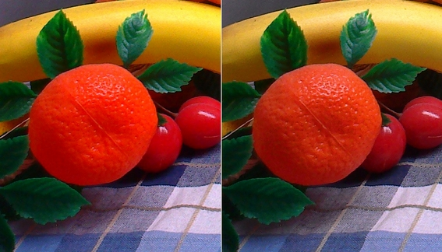
Colour Shaper
No colour Hue shift :
Colour shaper adapts automatically the processing to avoid clipping.
Channels clipping (Hue shift)
Original
Colour saturation
Image source is a Jpeg. The best quality is reached with Colour Shaper within an ISP.

Slide 3
Colour Shaper
No colour Hue shift :
Colour shaper adapts automatically the processing to avoid clipping.
Hue preserved
Original
Colour shaper
Image source is a Jpeg. The best quality is reached with Colour Shaper within an ISP.

Slide 4
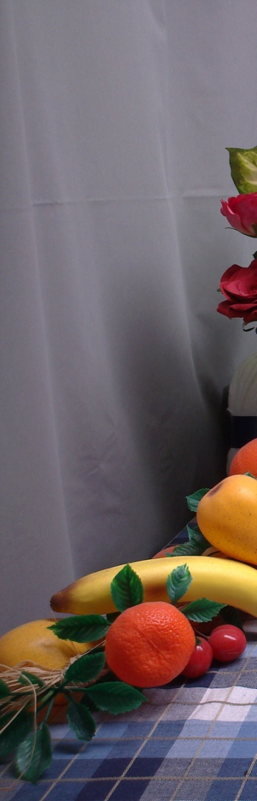
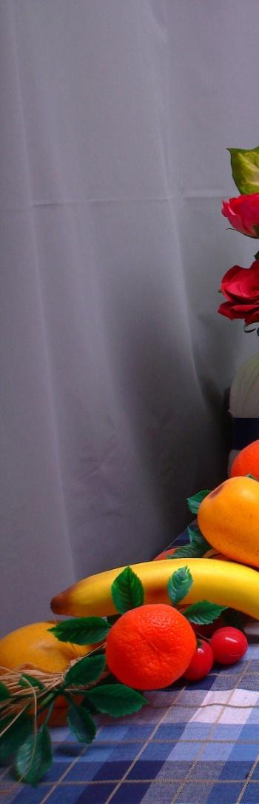
Colour Shaper
Preservation of neutral zones:
Thanks to this, Colour shaper gives to the user the feeling that the white balance is better. It’s not a true white balance, but neutral zones do not have colour cast.
Red cast
Original
Colour saturation
Image source is a Jpeg. The best quality is reached with Colour Shaper within an ISP.

Slide 5
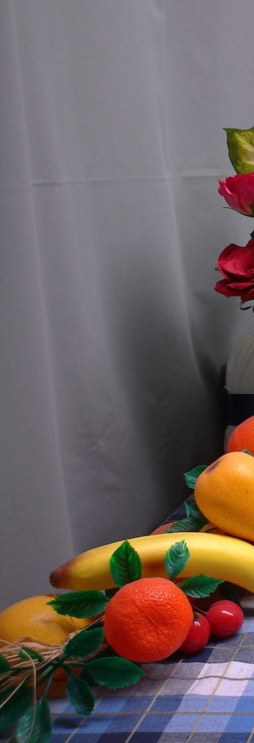
Colour Shaper
Preservation of neutral zones:
Thanks to this, Colour shaper gives to the user the feeling that the white balance is better. It’s not a true white balance, but neutral zones do not have colour cast.
True grey
Original
Colour shaper
Image source is a Jpeg. The best quality is reached with Colour Shaper within an ISP.

Slide 6
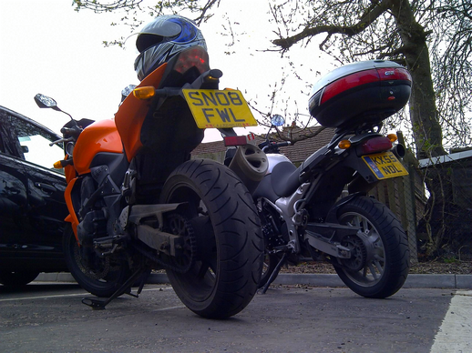

Colour Shaper
Preservation of neutral zones:
Colour saturation
Original
Purple grey
Image source is a Jpeg. The best quality is reached with Colour Shaper within an ISP.

Slide 7
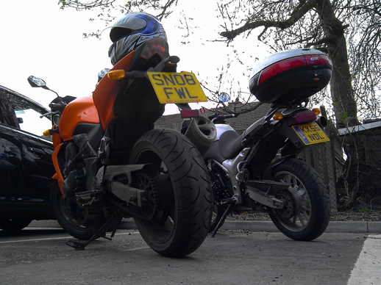
Colour Shaper
Preservation of neutral zones:
Colour shaper
Original
True grey
Image source is a Jpeg. The best quality is reached with Colour Shaper within an ISP.

Slide 8
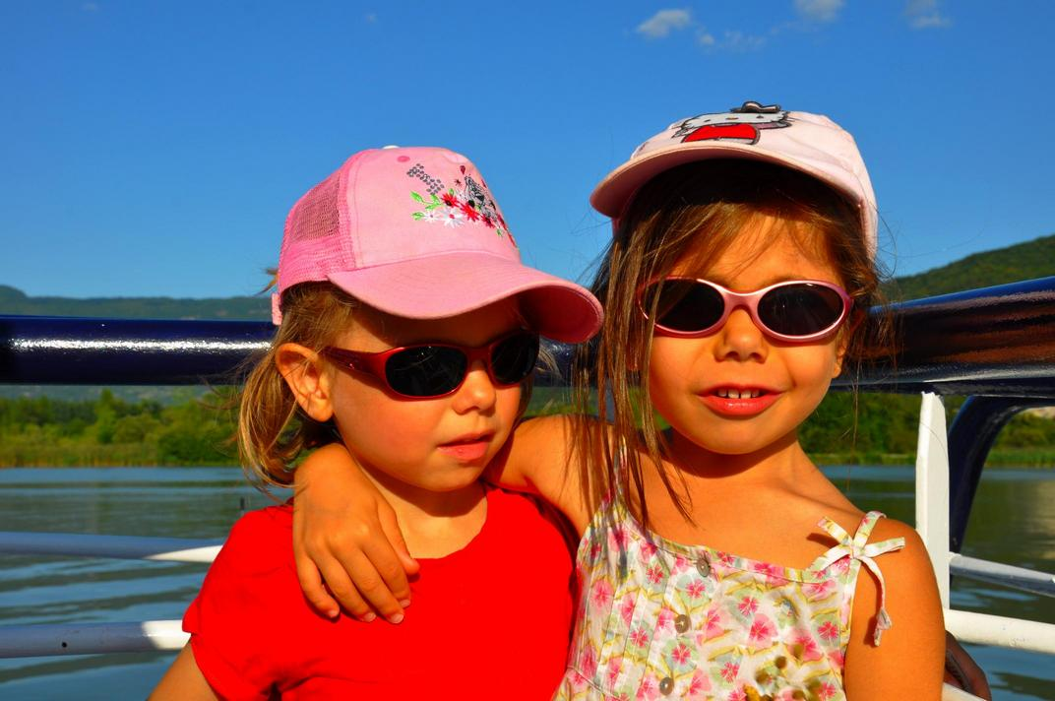
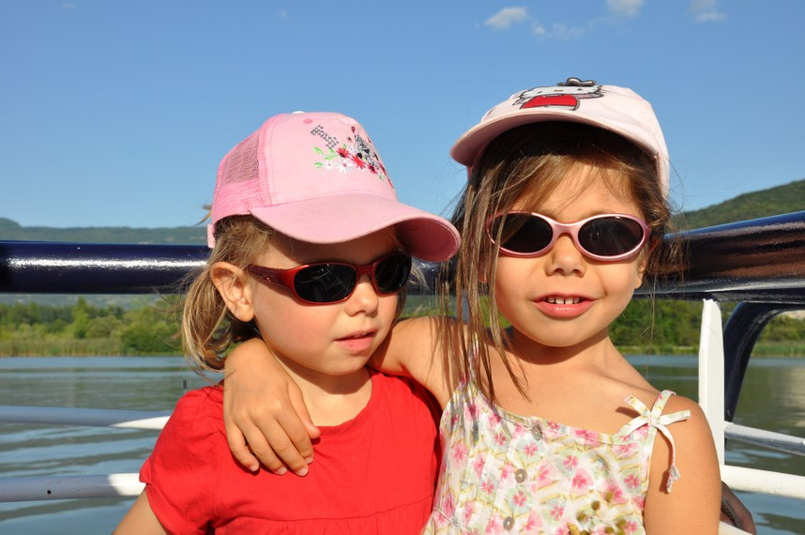
Colour Shaper
Limitation of skin tones Hue shift:
Colour shaper controls the enhancement of colour strength, to limit skin tones Hue shift.
Colour saturation
Original
Reddish skin
Image source is a Jpeg. The best quality is reached with Colour Shaper within an ISP.

Slide 9

Colour Shaper
Limitation of skin tones Hue shift:
Colour shaper controls the enhancement of colour strength, to limit skin tones Hue shift.
Colour shaper
Original
Skin colour preserved
Image source is a Jpeg. The best quality is reached with Colour Shaper within an ISP.

Slide 10
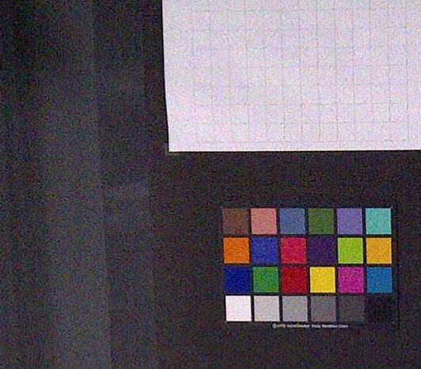
Colour Shaper
Hiding of colour noise in neutral zones:
Colour shaper better manages colour noises than colour saturation.
Colour saturation
Image source is a Jpeg. The best quality is reached with Colour Shaper within an ISP.

Slide 11
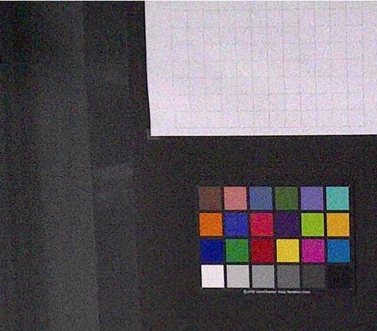
Colour Shaper
Hiding of colour noise in neutral zones:
Colour shaper better manages colour noises than colour saturation.
Colour shaper
Image source is a Jpeg. The best quality is reached with Colour Shaper within an ISP.

Slide 12
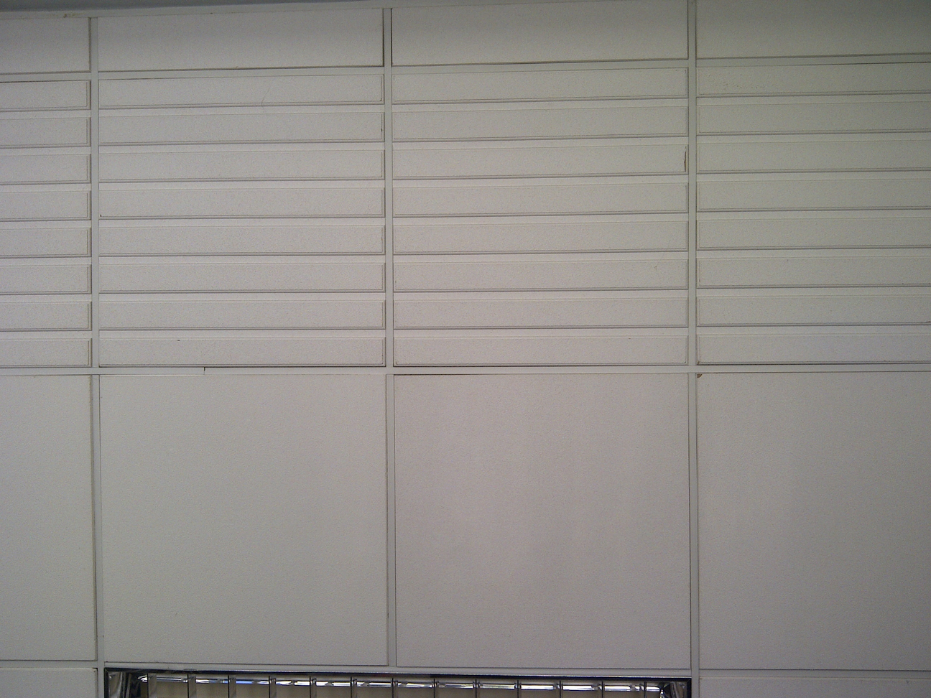
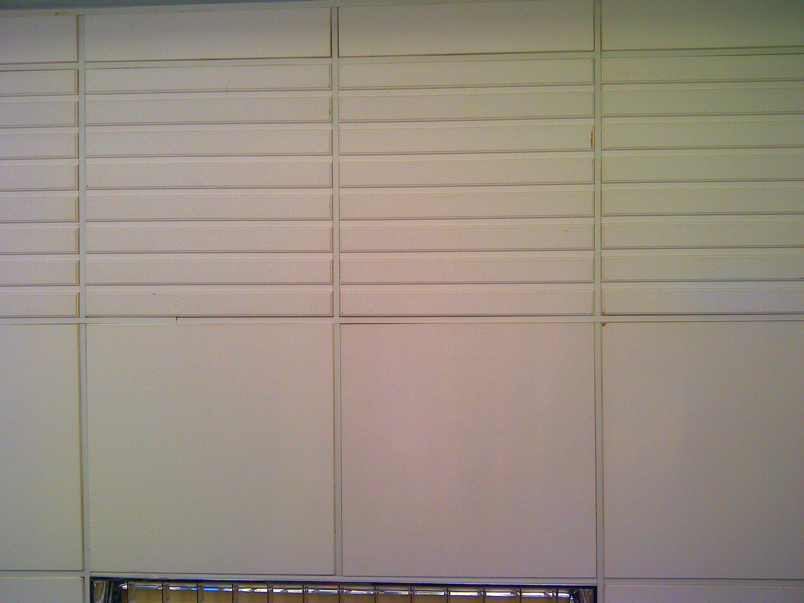
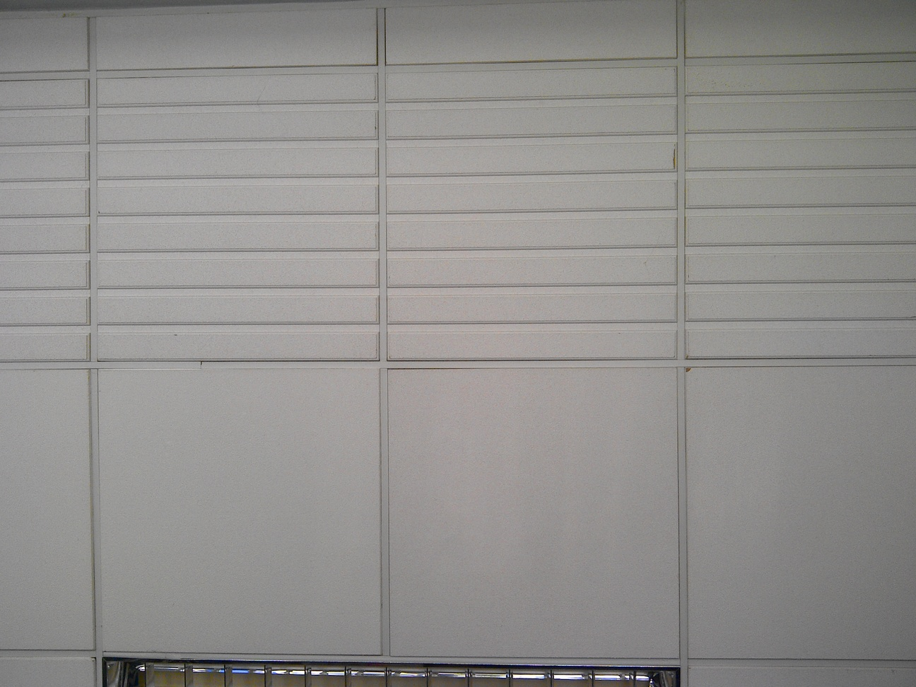
Colour Shaper
Prevention of colour shading increase in neutral zones:
Standard saturation
Color Shaper
Input image
Standard saturation
Color Shaper saturation
Image source is a Jpeg. The best quality is reached with Colour Shaper within an ISP.

Slide 13
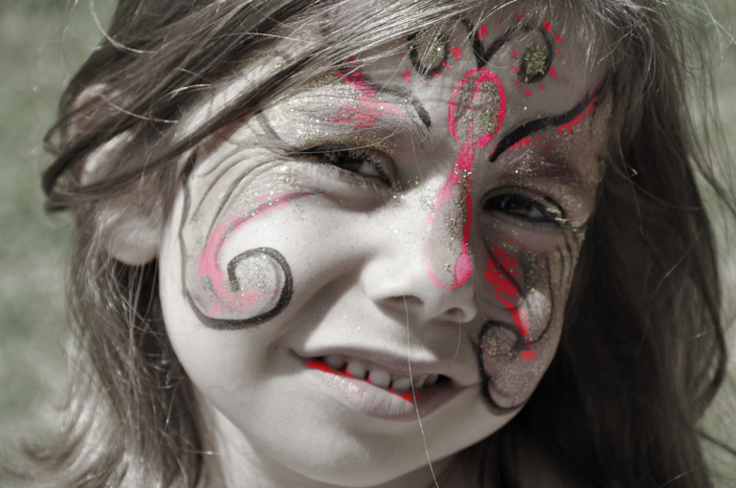
Colour Shaper
Fun effects:
Image source is a Jpeg. The best quality is reached with Colour Shaper within an ISP.

Slide 14
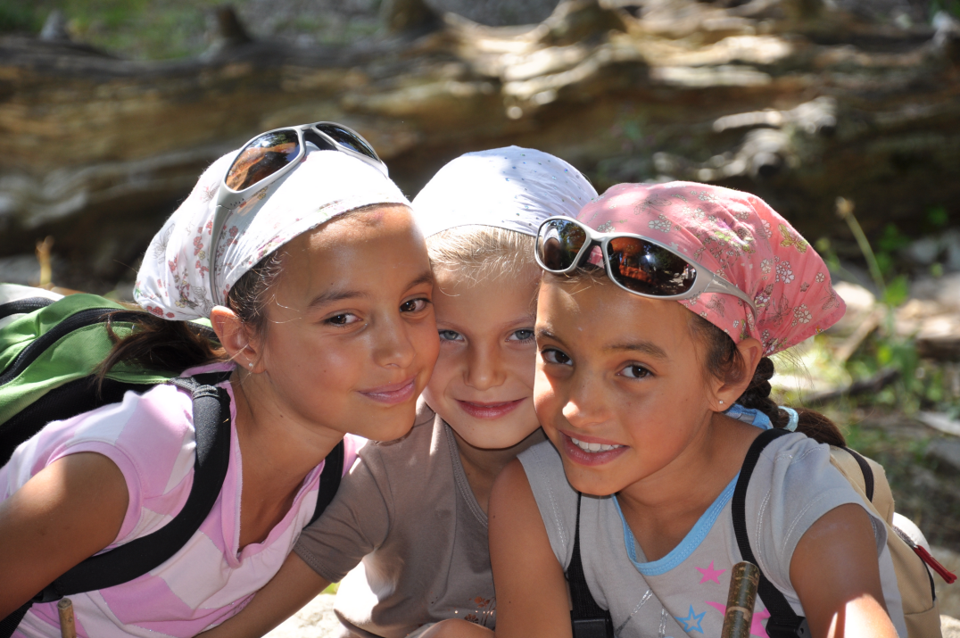
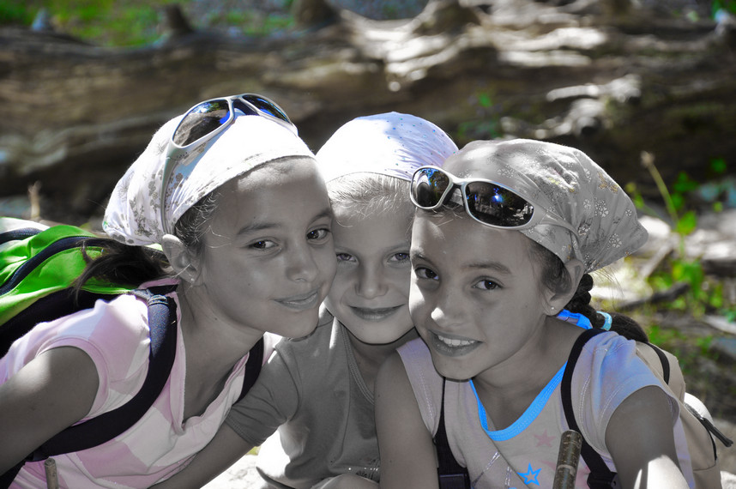
Colour Shaper
Original
Modified

Slide 15
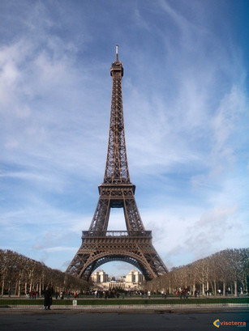
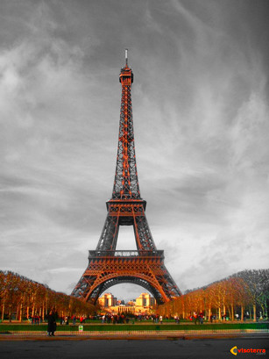
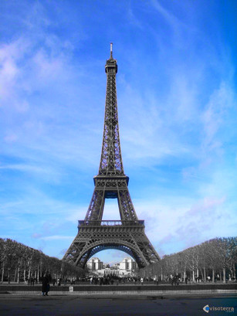
Colour Shaper
Original
Modified

Slide 16
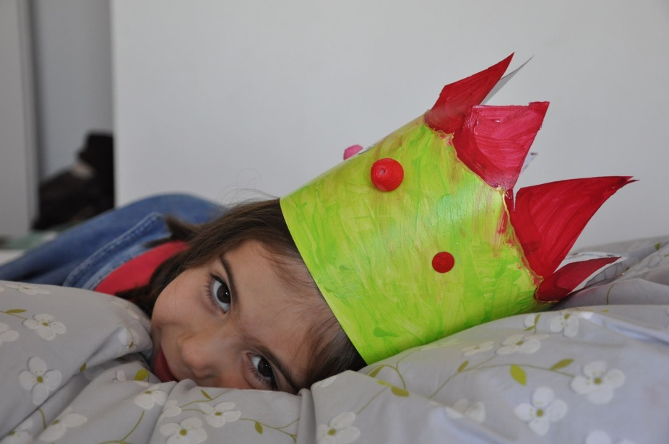
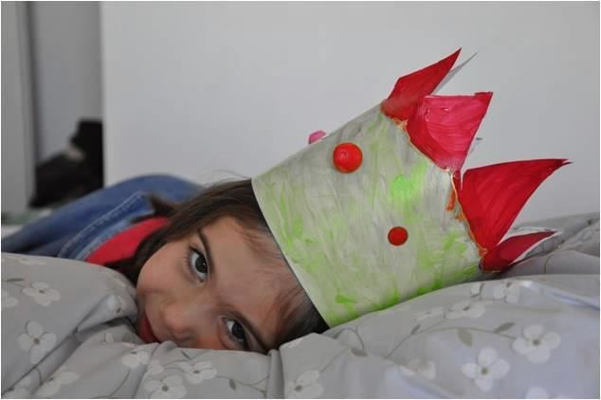
Colour Shaper
Modified
Original

